Slide 1
Introduction to Generative Adversarial Network (GAN)
Student: Szu-Chi Chung
Notes:
http://www.inference.vc/my-summary-of-adversarial-training-nips-workshop/
I should follow this https://epsilon-lee.github.io/blog/GANs-Basics.html
F-GAN
W-GAN x 2
LS-GAN
Loss sentisive
EB-GAN

Slide 2
Awesome GAN
Paper/resources and tips
https://github.com/nightrome/really-awesome-gan
GAN zoo
https://github.com/hindupuravinash/the-gan-zoo
Applications
https://github.com/nashory/gans-awesome-applications
Courtesy of
http://www.iangoodfellow.com/slides/
http://speech.ee.ntu.edu.tw/~tlkagk/courses.html
http://cs231n.stanford.edu/
Notes:
https://github.com/zhangqianhui/AdversarialNetsPapers

Slide 3
Outline
Motivation
Taxonomy
Fully Visible Belief Network
Variational Auto-Encoder
Generative Adversarial Network
Basic Ideas
Training Procedure
Variants of GAN
Issues
Mode Collapse
Training Stalability
Conditional GAN (Using the code)

Slide 4
Motivation

Slide 5
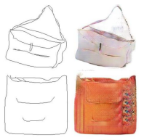
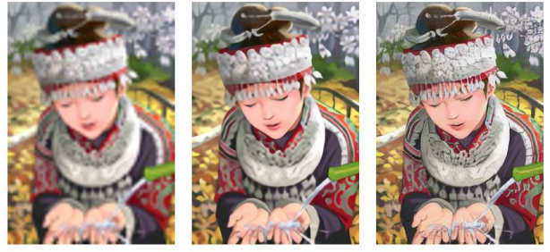
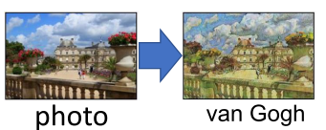
Why Generative Models?
Given training data, generate new samples from the same distribution
Applications
Intrinsically require realistic generation of samples
Generative models of time-series data can be used for simulation and
planning: reinforcement learning applications
Semi-supervised learning: reduce amount of label samples required
Notes:
Realistic samples for artwork, super-resolution, colorization, etc.
Simulating possible features
Addresses density estimation, a core problem in unsupervised learning

Slide 6
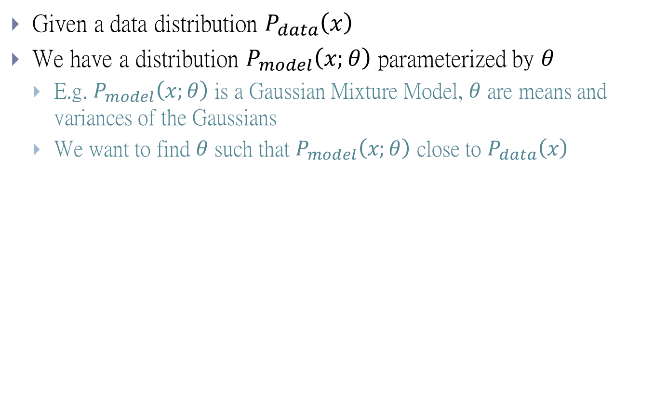
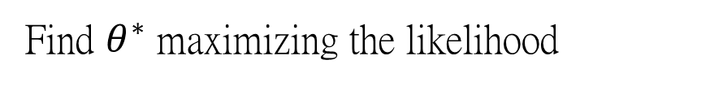
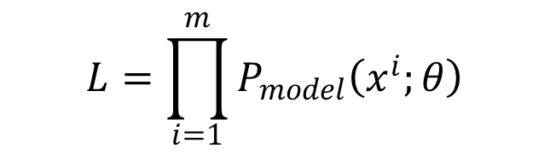
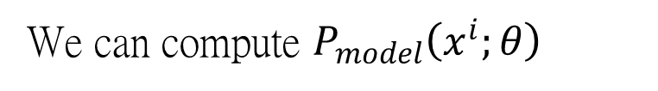
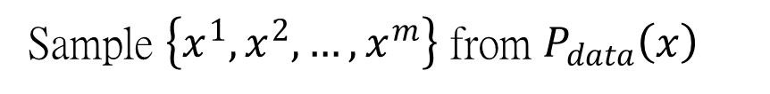
Maximum Likelihood Estimation
Given a data distribution $P_{data}\left(x\right)$
We have a distribution $P_{model}\left(x;θ\right)$ parameterized by $θ$
E.g. $P_{model}\left(x;θ\right)$ is a Gaussian Mixture Model, $θ$ are means and variances of the Gaussians
We want to find $θ$ such that $P_{model}\left(x;θ\right)$ close to $P_{data}\left(x\right)$
Sample $\left\{x^{1},x^{2},…,x^{m}\right\}$ from $P_{data}\left(x\right)$
We can compute $P_{model}\left(x^{i};θ\right)$
Likelihood of generating the samples
$$L=\prod_{i=1}^{m}{P_{model}\left(x^{i};θ\right)}$$
It is difficult to compute the likelihood for complex model like NN.
Find $θ^{∗}$ maximizing the likelihood
Notes:
Kernel density estimation
X fixed(given) find theta

Slide 7
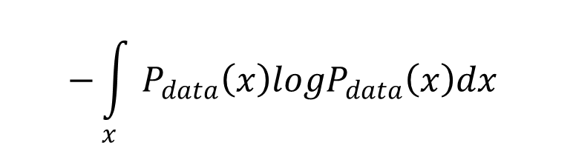
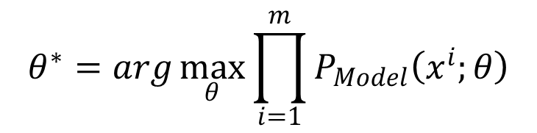
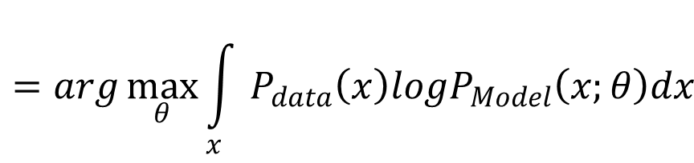
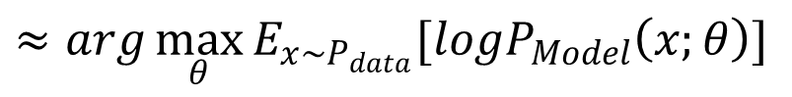
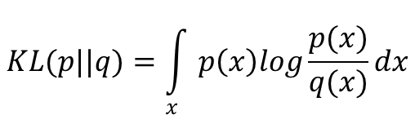
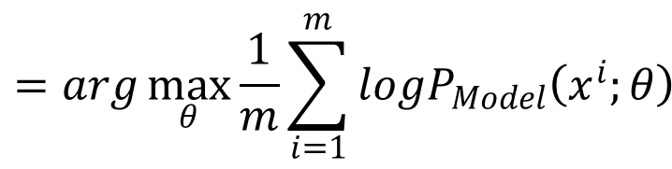
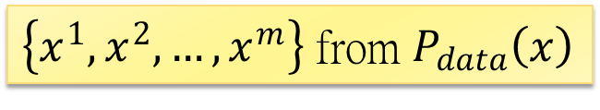
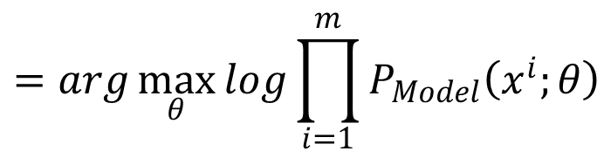
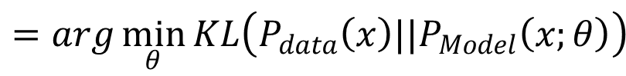
Maximum Likelihood Estimation
$$KL(p||q)=\int_{x}{p\left(x\right)log\frac{p(x)}{q(x)}}dx$$
$$θ^{∗}=arg\max_{θ}{\prod_{i=1}^{m}{P_{Model}\left(x^{i};θ\right)}}$$
$$=arg\max_{θ}{log\prod_{i=1}^{m}{P_{Model}\left(x^{i};θ\right)}}$$
$$=arg\max_{θ}{\frac{1}{m}\sum_{i=1}^{m}{logP_{Model}\left(x^{i};θ\right)}}$$
$\left\{x^{1},x^{2},…,x^{m}\right\}$ from $P_{data}\left(x\right)$
$$≈arg\max_{θ}{E_{x\sim P_{data}}[logP_{Model}\left(x;θ\right)] }$$
$$=arg\max_{θ}{\int_{x}{P_{data}\left(x\right)logP_{Model}\left(x;θ\right)dx} }$$
$$−{\int_{x}{P_{data}\left(x\right)logP_{data}\left(x\right)dx} }$$
$$=arg\min_{θ}{KL\left(P_{data}\left(x\right)||P_{Model}\left(x;θ\right)\right) }$$
Notes:
Log optimization較好做
approximate the expectation with respect to the unknown distribution with the empirical expectation defined by the data set
The KL-divergence is asymmetric
KL >= 0

Slide 8
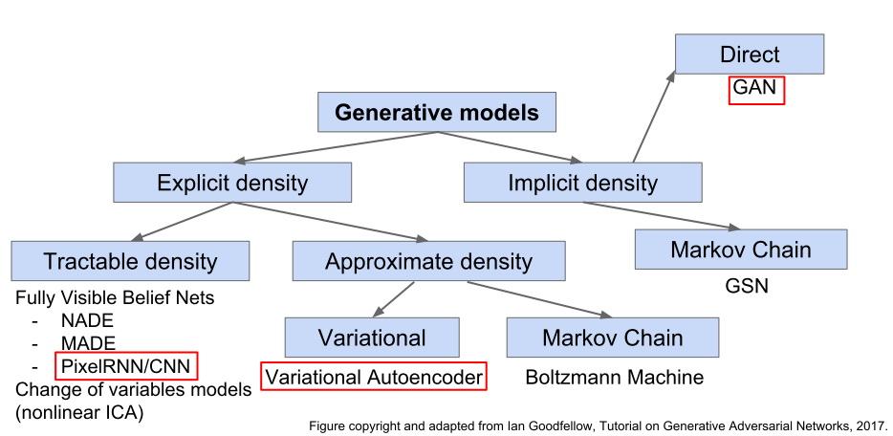
Taxonomy
Notes:
Several flavors:
Explicit density estimation: explicitly define and solve for pmodel(x)
Implicit density estimation: learn model that can sample from pmodel(x) w/o explicitly defining it

Slide 9
Fully Visible Belief Network

Slide 10
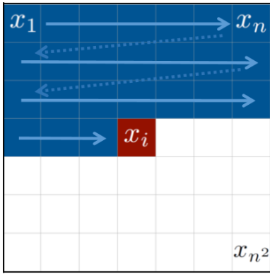
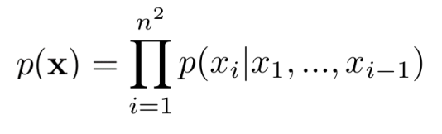
Fully Visible Belief Network
Step by step
Explicit density model
Use chain rule to decompose likelihood of an image x into product of 1-d distributions:
Then maximize likelihood of training data
Will need to define ordering of “previous pixels”
Complex distribution over pixel values
Express using a neural network!
PixelCNN, Wavenet etc.
Notes:
function

Slide 11
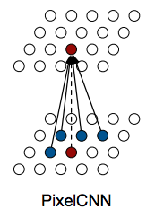
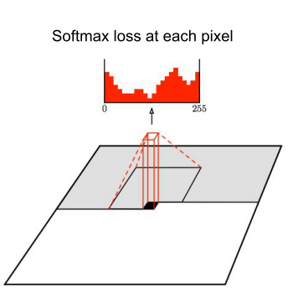
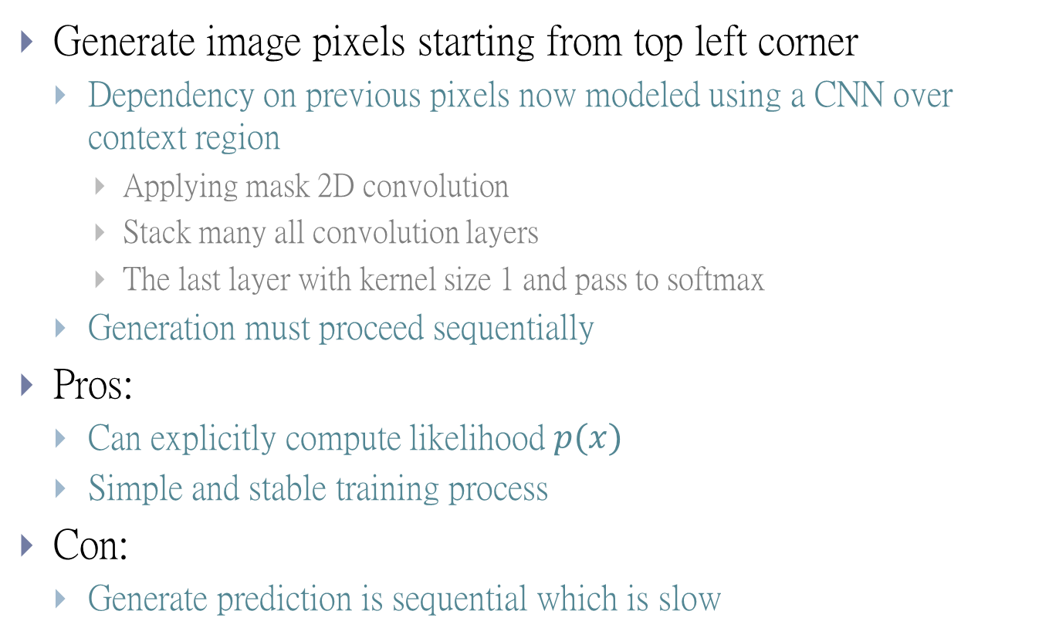
Fully Visible Belief Network
Generate image pixels starting from top left corner
Dependency on previous pixels now modeled using a CNN over context region
Applying mask 2D convolution
Stack many all convolution layers
The last layer with kernel size 1 and pass to softmax
Generation must proceed sequentially
Pros:
Can explicitly compute likelihood $p(x)$
Simple and stable training process
Con:
Generate prediction is sequential which is slow
Notes:
http://setosa.io/ev/image-kernels/
https://cs231n.github.io/assets/conv-demo/index.html

Slide 12
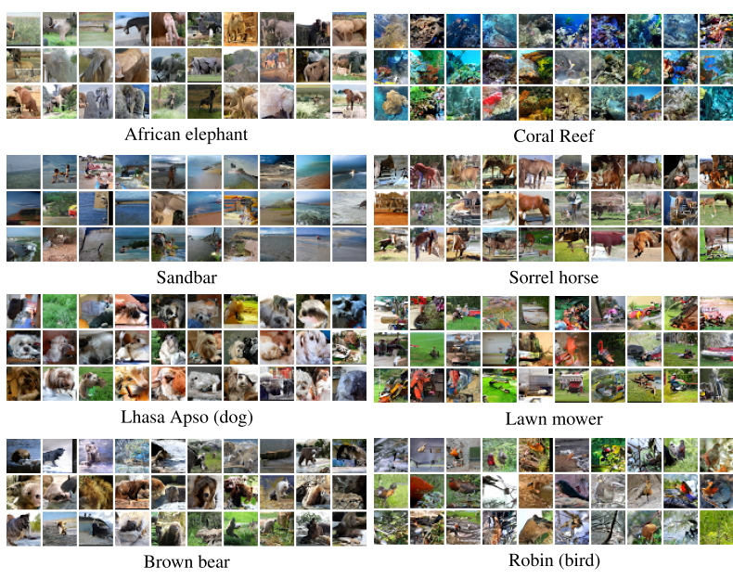
Generated Image From PixelCNN

Slide 13
Variational Auto-Encoder

Slide 14
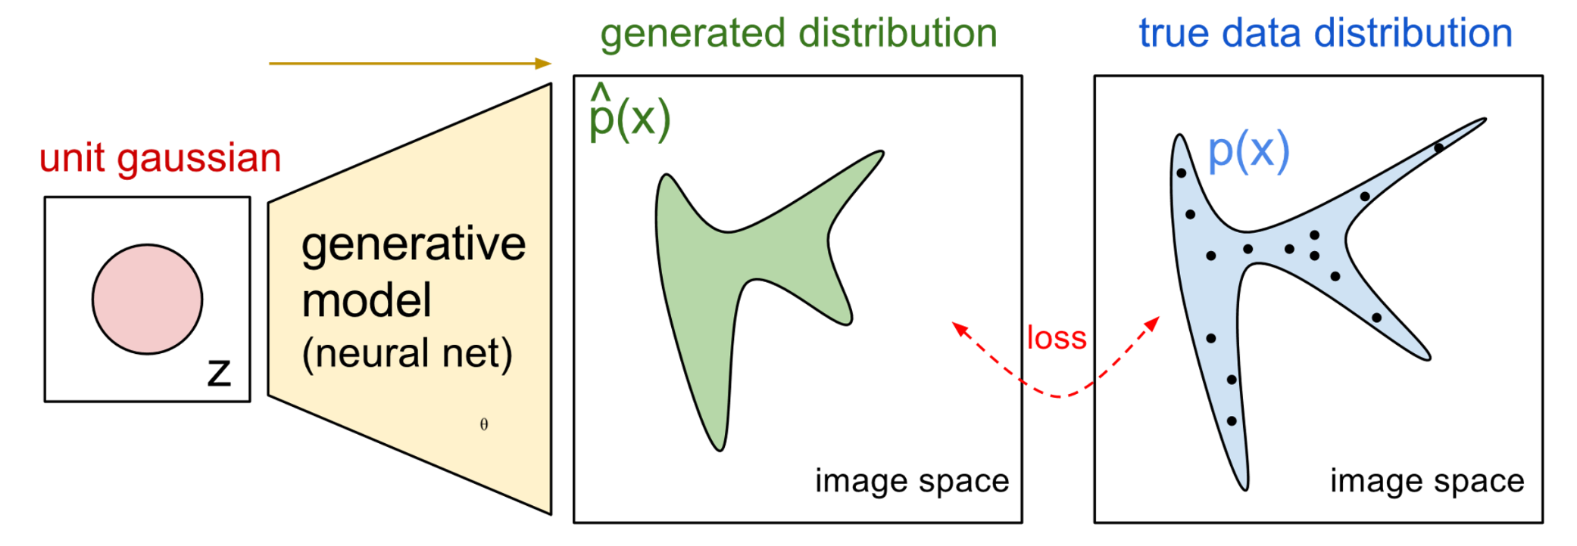
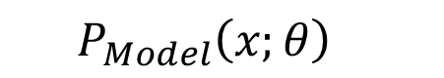
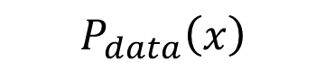
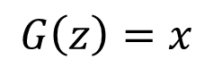
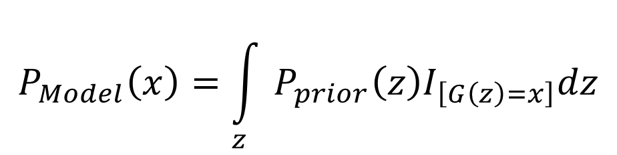
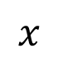
Maximum Likelihood Estimation - One Shot
$${P_{Model}\left(x;θ\right)}_{}$$
$$P_{data}\left(x\right)$$
$$G\left(z\right)=x$$
$$x$$
$$P_{Model}\left(x\right)=\int_{z}{P_{prior}\left(z\right)I_{\left[G\left(z\right)=x\right]}dz}$$
https://blog.openai.com/generative-models/
Notes:
Distribution to distribution
NN powerful

Slide 15
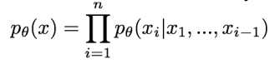
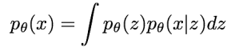
Variational Auto-Encoder
PixelCNNs define tractable density function, optimize likelihood of training data:
VAEs define intractable density function with latent z:
Cannot optimize directly, derive and optimize lower bound on likelihood instead

Slide 16
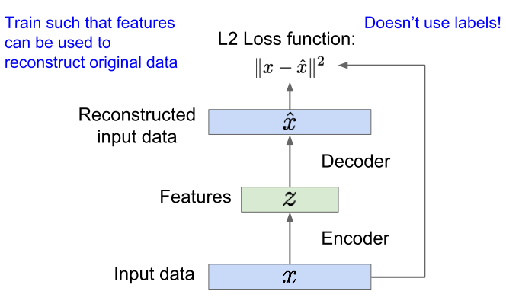
Variational Auto-Encoder
Vanilla auto-encoder
Notes:
If the layer is linear and the dimension of z is smaller than x it is the same as PCA
Encoder can be used to initialize a supervised model

Slide 17
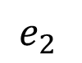
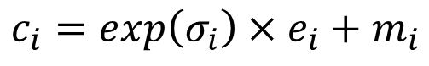
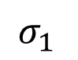
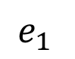
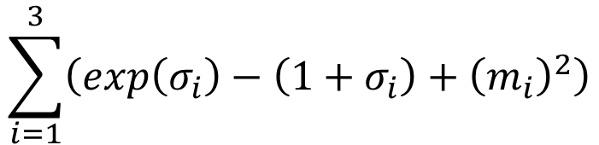
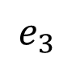
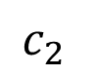
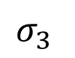
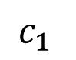
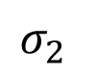
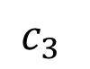
Variational Auto-Encoder
Minimize reconstruction error
m₁
m₂
NN
Encoder
m₃
$$c_{1}$$
input
NN
Decoder
$$σ_{1}$$
exp
+
$$c_{2}$$
output
$$σ_{2}$$
$$c_{3}$$
$$σ_{3}$$
X
$$c_{i}=exp\left(σ_{i}\right)×e_{i}+m_{i}$$
$$e_{1}$$
From a normal distribution
$$e_{2}$$
Minimize
$$e_{3}$$
$$\sum_{i=1}^{3}{\left(exp\left(σ_{i}\right)−\left(1+σ_{i}\right)+{\left(m_{i}\right)}^{2}\right)}$$
Auto-Encoding Variational Bayes, https://arxiv.org/abs/1312.6114
Notes:
Structure latent space

Slide 18
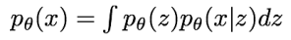
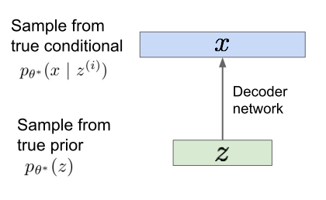
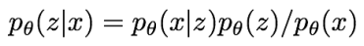
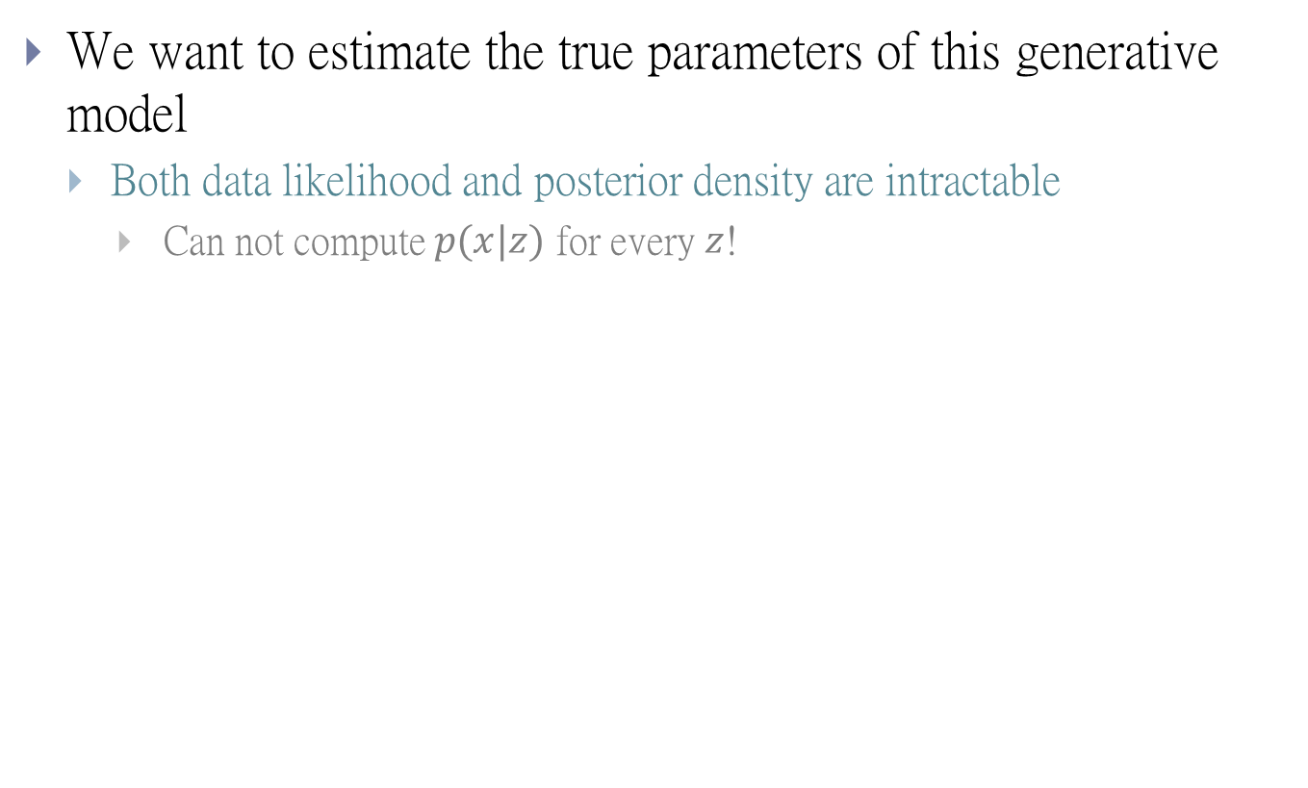
Variational Auto-Encoder
We want to estimate the true parameters of this generative model
Both data likelihood and posterior density are intractable
Can not compute $p(x|z)$ for every $z$!
Notes:
Variational autoencoders, however, augment autoencoders with a little bit of statistical magic that forces them to learn continuous, highly structured latent spaces. They have turned out to
be a very powerful tool for image generation

Slide 19
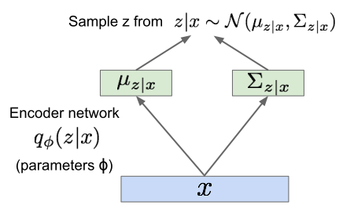
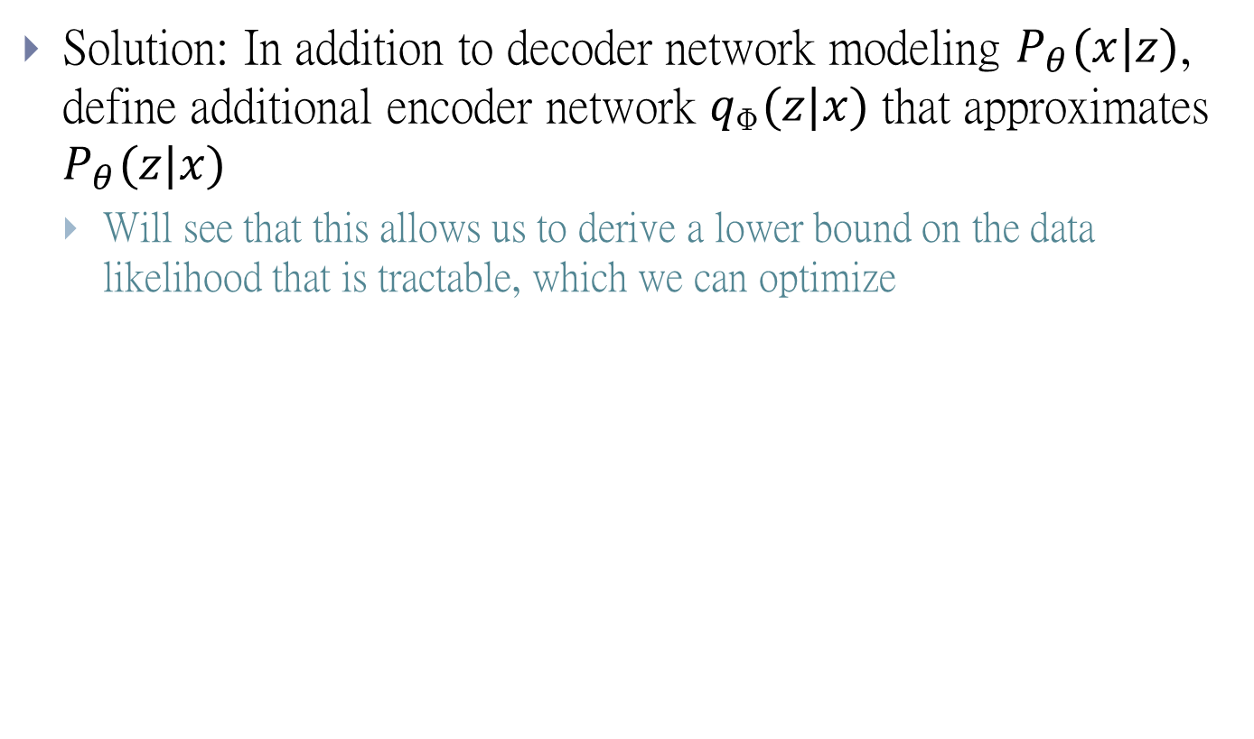
Variational Auto-Encoder
Solution: In addition to decoder network modeling $P_{θ}(x|z)$, define additional encoder network $q_{\text{ɸ}}(z|x)$ that approximates $P_{θ}(z|x)$
Will see that this allows us to derive a lower bound on the data likelihood that is tractable, which we can optimize

Slide 20

Variational Auto-Encoder
Now equipped with our encoder and decoder networks, lets work out the (log) data likelihood:

Slide 21

Variational Auto-Encoder
Notes:
Evidence Lower Bound (ELOB)

Slide 22

VAE on CIFAR 10

Slide 23
Problems of VAE
Pros:
Easier to train than GAN
Easy to relate image with low dimensional latent variables
Cons:
Maximizes lower bound of likelihood: okay, but not as good evaluation as PixelRNN/PixelCNN
Samples blurrier and lower quality compared to state-of-the-art (GANs)

Slide 24
Basic Idea of GAN

Slide 25
Basic Ideas
GANs: do not work with any explicit density function
Just want to have the ability to sample
Take game-theoretic approach: learn to generate from training distribution through 2-player game
Problem: Want to sample from complex, high-dimensional training distribution.
Solution: Sample from a simple distribution, e.g. random noise.
Learn transformation to training distribution. (Like Decoder in VAE)

Slide 26



The Evolution of Generation
NN
Generator
v1
NN
Generator
v2
NN
Generator
v3
Discri-minator
v1
Discri-minator
v2
Discri-minator
v3
Binary
Classifier
Real images:

Slide 27
GAN - Discriminator
NN
Generator
v1
Randomly sample a vector
0
0
0
0
Something like Decoder in VAE
Real images:
1
1
1
1
image
Discri-minator
v1
Fixe generator, train a classifier
1/0
(real or fake)

Slide 28


GAN - Generator
Randomly sample a vector
Updating the parameters of generator
NN
Generator
v1
v2
The output be classified as “real” (as close to 1 as possible)
Generator + Discriminator = a network
Discri-minator
v1
Using gradient descent to update the parameters in the generator, but fix the discriminator
1.0
0.13

Slide 29

GAN - Overall
Generator network: try to fool the discriminator by generating real-looking images
Discriminator network: try to distinguish between real and fake images
Notes:
Discriminator looking at big picture
Generator solve arg max provide negative sample

Slide 30


Under The Hood
Generator $G$
$G$ is a function, input $z$, output $x$
Given a prior distribution $Pprior(z)$, a probability distribution $PG(x)$ is defined by function $G$
Discriminator $D$
$D$ is a function, input $x$, output scalar
Evaluate the “difference” between $PG(x)$ and $Pdata(x)$
We can summarize the game with a value function $V(G,D)$.
$$G^{∗}=arg\min_{G}{\max_{D}{V\left(G,D\right)}}$$
Notes:
Discriminator 會算divergence!!

Slide 31


Under The Hood
Alternate between:
Gradient ascent on discriminator
Cross entropy for binary classifier
Gradient descent on generator

Slide 32


Under The Hood
Alternate between:
Gradient ascent on discriminator
Gradient ascent on generator (Non-saturating game or NSGAN)
Instead of minimizing likelihood of discriminator being correct, now maximize likelihood of discriminator being wrong. Same objective of fooling discriminator, but now higher gradient signal for bad samples => works much better!
Notes:
Aside: Jointly training two networks is challenging, can be unstable. Choosing objectives with better loss
landscapes helps training, is an active area of research.

Slide 33


Under The Hood
Train jointly in minimax game
Discriminator ($θ_{d}$) wants to maximize objective such that $D(x)$ is close to $1$ (real) and $D(G(z))$is close to $0$ (fake)
Generator ($θ_{g}$) wants to minimize objective such that $D(G(z))$ is close to $1$ (discriminator is fooled into thinking generated $G(z)$ is real)

Slide 34





$$\text{Under} \text{The} \text{Hood}$$
$$G^{∗}=arg\min_{G}{\max_{D}{V\left(G,D\right)}}$$
Given $G$, what is the optimal $D$* maximizing
Given $x$, the optimal $D∗$ maximizing
$$V=E_{x∼P_{data}}\left[logD\left(x\right)\right]+E_{x∼P_{G}}\left[log\left(1−D\left(x\right)\right)\right]$$
$$=\int_{x}{P_{data}\left(x\right)logD\left(x\right)}dx+\int_{x}{P_{G}\left(x\right)log\left(1−D\left(x\right)\right)}dx$$
$$=\int_{x}{\left[P_{data}\left(x\right)logD\left(x\right)+P_{G}\left(x\right)log\left(1−D\left(x\right)\right)\right]}dx$$
$$P_{data}\left(x\right)logD\left(x\right)+P_{G}\left(x\right)log\left(1−D\left(x\right)\right)$$

Slide 35









$$\text{Under} \text{The} \text{Hood}$$
$$G^{∗}=arg\min_{G}{\max_{D}{V\left(G,D\right)}}$$
Given $x$, the optimal $D∗$ maximizing
Find $D∗$ maximizing:
$$P_{data}\left(x\right)logD\left(x\right)+P_{G}\left(x\right)log\left(1−D\left(x\right)\right)$$
a
D
b
D
$$f\left(D\right)=alog(D)+blog\left(1−D\right)$$
$$\frac{df\left(D\right)}{dD}=a×\frac{1}{D}+b×\frac{1}{1−D}×\left(−1\right)$$
$$=0$$
$$a×\frac{1}{D^{∗}}=b×\frac{1}{1−D^{∗}}$$
$$a×\left(1−D^{∗}\right)=b×D^{∗}$$
$$a−aD^{∗}=bD^{∗}$$
$$D^{∗}=\frac{a}{a+b}$$
$$D^{∗}\left(x\right)=\frac{P_{data}\left(x\right)}{P_{data}\left(x\right)+P_{G}\left(x\right)}$$
0 <
< 1
Notes:
sigmoid

Slide 36













$$\text{Under} \text{The} \text{Hood}$$
$$V=E_{x∼P_{data}}\left[logD\left(x\right)\right]$$
$$+E_{x∼P_{G}}\left[log\left(1−D\left(x\right)\right)\right]$$
$$\max_{D}{V\left(G,D\right)}$$
$$=V\left(G,D^{∗}\right)$$
$$D^{∗}\left(x\right)=\frac{P_{data}\left(x\right)}{P_{data}\left(x\right)+P_{G}\left(x\right)}$$
$$=E_{x∼P_{data}}\left[log\frac{P_{data}\left(x\right)}{P_{data}\left(x\right)+P_{G}\left(x\right)}\right]$$
$$+E_{x∼P_{G}}\left[log\frac{P_{G}\left(x\right)}{P_{data}\left(x\right)+P_{G}\left(x\right)}\right]$$
$$\frac{1}{2}$$
$$=\int_{x}{P_{data}\left(x\right)log\frac{P_{data}\left(x\right)}{P_{data}\left(x\right)+P_{G}\left(x\right)}}dx$$
$$\frac{1}{2}$$
2
$$+\int_{x}{P_{G}\left(x\right)log\frac{P_{G}\left(x\right)}{P_{data}\left(x\right)+P_{G}\left(x\right)}}dx$$
$$+2log\frac{1}{2}$$
2
$$−2log2$$
Notes:
Converge

Slide 37






$$\text{Under} \text{The} \text{Hood}$$
$$\max_{D}{V\left(G,D\right)}$$
$$=V\left(G,D^{∗}\right)$$
$$D^{∗}\left(x\right)=\frac{P_{data}\left(x\right)}{P_{data}\left(x\right)+P_{G}\left(x\right)}$$
$$=−2log2+\int_{x}{P_{data}\left(x\right)log\frac{P_{data}\left(x\right)}{\left(P_{data}\left(x\right)+P_{G}\left(x\right)\right)/2}}dx$$
$$+\int_{x}{P_{G}\left(x\right)log\frac{P_{G}\left(x\right)}{\left(P_{data}\left(x\right)+P_{G}\left(x\right)\right)/2}}dx$$
$$=−2log2+KL\left(P_{data}\left(x\right)||\frac{P_{data}\left(x\right)+P_{G}\left(x\right)}{2}\right)$$
$$+KL\left(P_{G}\left(x\right)||\frac{P_{data}\left(x\right)+P_{G}\left(x\right)}{2}\right)$$
$$=−2log2+2JSD\left(P_{data}\left(x\right)||P_{G}\left(x\right)\right)$$
Jensen-Shannon divergence
Notes:
Symmetric!
訂不同V產生不同divergence

Slide 38



Under The Hood
$$V=E_{x∼P_{data}}\left[logD\left(x\right)\right]$$
$$+E_{x∼P_{G}}\left[log\left(1−D\left(x\right)\right)\right]$$
Generator $G$, Discriminator $D$
Looking for $G^{∗}$ such that
Given $G$, $\max_{D}{V\left(G,D\right)}$
What is the optimal $G$?
$$G^{∗}=arg\min_{G}{\max_{D}{V\left(G,D\right)}}$$
0 <
< log 2
$$=−2log2+2JSD\left(P_{data}\left(x\right)||P_{G}\left(x\right)\right)$$
$$P_{G}\left(x\right)=P_{data}\left(x\right)$$
$V\left(G_{},D_{}^{∗}\right)$ is the JS divergence between $P_{data}\left(x\right)$ and $P_{G_{}}\left(x\right)$
Notes:
兩distribution沒交集 -> log2

Slide 39


In Practice
$$V=E_{x∼P_{data}}\left[logD\left(x\right)\right]$$
$$+E_{x∼P_{G}}\left[log\left(1−D\left(x\right)\right)\right]$$
Given G, how to compute $\max_{D}{V\left(G,D\right)}$
Sample $\left\{x^{1},x^{2},…,x^{m}\right\}$ from $P_{data}\left(x\right)$, sample $\left\{{\tilde{x}}^{1},{\tilde{x}}^{2},…,{\tilde{x}}^{m}\right\}$ from generator $P_{G}\left(x\right)$
$$\tilde{V}=\frac{1}{m}\sum_{i=1}^{m}{logD\left(x^{i}\right)}+\frac{1}{m}\sum_{i=1}^{m}{log\left(1−D\left({\tilde{x}}^{i}\right)\right)}$$
Maximize
Binary Classifier
Output is D(x)
Minimize Cross-entropy
If x is a positive example
Minimize –log D(x)
If x is a negative example
Minimize –log(1-D(x))
Notes:
無法求積分
用sample

Slide 40


In Practice
Binary Classifier
Output is f(x)
Minimize Cross-entropy
If x is a positive example
Minimize –log f(x)
If x is a negative example
Minimize –log(1-f(x))
D is a binary classifier (can be deep) with parameters $θ_{d}$
$\left\{x^{1},x^{2},…,x^{m}\right\}$ from $P_{data}\left(x\right)$
Positive examples
$\left\{{\tilde{x}}^{1},{\tilde{x}}^{2},…,{\tilde{x}}^{m}\right\}$ from $P_{G}\left(x\right)$
Negative examples

Slide 41

The Training Process
Notes:
第一個部分算JS divergence

Slide 42
LSGAN/DCGAN

Slide 43
So Many GANs ……
Modifying the Optimization of GAN
F-GAN
WGAN
Least-square GAN
Loss Sensitive GAN
Energy-based GAN
Boundary-seeking GAN
Unroll GAN
……
Different Structure from the Original GAN
Conditional GAN
Semi-supervised GAN
InfoGAN
BiGAN
Cycle GAN
Disco GAN
VAE-GAN
……
Notes:
Application:
deep convolutional generative adversarial networks (DCGANs)

Slide 44

Least-Square GAN
Converge faster and more stable
For discriminator
For generator
$$\min_{D}{\frac{1}{2}E_{x\sim P_{data}}\left[{\left(D\left(x\right)−b\right)}^{2}\right]+\frac{1}{2}E_{x\sim P_{G}}\left[{\left(D\left(x\right)−a\right)}^{2}\right]}$$
1
0
1
$$\min_{D}{\frac{1}{2}E_{z\sim P_{data}}\left[{\left(D\left(G\left(z\right)\right)−c\right)}^{2}\right]}$$
Notes:
Generator離目標很遠會有penealize

Slide 45

Deep Convolutional GAN
Create sharper image samples
Generator is an upsampling network with fractionally-strided convolutions
Discriminator is a convolutional network
Notes:
https://github.com/vdumoulin/conv_arithmetic

Slide 46



Deep Convolutional GAN
CNN will find the filter(kernel) for convolution
Each neuron is only connected to small region called receptive field
All the neuron in the same map share same weights (Extend over all depth)

Slide 47

Deep Convolutional GAN
Deconvolution layer is actually perform convolution
https://github.com/vdumoulin/conv_arithmetic

Slide 48
Mode Collapse

Slide 49

Mode Collapse
Generated Distribution
Data Distribution

Slide 50



Mode Collapse
$$P_{data}$$
What we want …(Unroll GAN can result in this)
In reality …

Slide 51








Flaw in Optimization?
$$KL=\int{P_{data}log\frac{P_{data}}{P_{G}}dx}$$
Reverse $KL=\int{P_{G}log\frac{P_{G}}{P_{data}}dx}$ (Like JS divergence)
$$P_{data}$$
$$P_{data}$$
$$P_{G}$$
$$P_{G}$$
Maximum likelihood (minimize KL$(P_{data}||P_{G}$))
Minimize KL$(P_{G}||P_{data}$) (reverse KL)
This may not be the reason (based on Ian Goodfellow’s tutorial)
Notes:
避免 divergence 無窮大

Slide 52









F-divergence
$$D_{f}\left(P||Q\right)=\int_{x}{q\left(x\right)f\left(\frac{p\left(x\right)}{q\left(x\right)}\right)dx}$$
f is convex
$D_{f}\left(P||Q\right)$ evaluates the difference of P and Q
f(1) = 0
= 1
If $p\left(x\right)=q\left(x\right)$ for all $x$
$$D_{f}\left(P||Q\right)=\int_{x}{q\left(x\right)f\left(\frac{p\left(x\right)}{q\left(x\right)}\right)dx}$$
smallest
$$=0$$
$$D_{f}\left(P||Q\right)=\int_{x}{q\left(x\right)f\left(\frac{p\left(x\right)}{q\left(x\right)}\right)dx}$$
= 0
If P and Q are the same distributions,
$$≥f\left(\int_{x}{q\left(x\right)\frac{p\left(x\right)}{q\left(x\right)}dx}\right)$$
Because f is convex
$D_{f}\left(P||Q\right)$ has the smallest value, which is 0
$$=f\left(1\right)=0$$
Notes:
$P$ and $Q$ are two distributions. $p\left(x\right)$ and $q\left(x\right)$ are the probability of sampling $x$.
The constraint of f is for non-negative
http://www.stat.berkeley.edu/~aditya/resources/STAT212aOverview.pdf

Slide 53









F-divergence
$$f\left(x\right)=xlogx$$
KL
$$D_{f}\left(P||Q\right)=\int_{x}{q\left(x\right)\frac{p\left(x\right)}{q\left(x\right)}log\left(\frac{p\left(x\right)}{q\left(x\right)}\right)dx}$$
$$=\int_{x}{p\left(x\right)log\left(\frac{p\left(x\right)}{q\left(x\right)}\right)dx}$$
$$f\left(x\right)=−logx$$
Reverse KL
$$D_{f}\left(P||Q\right)=\int_{x}{q\left(x\right)\left(−log\left(\frac{p\left(x\right)}{q\left(x\right)}\right)\right)dx}$$
$$=\int_{x}{q\left(x\right)log\left(\frac{q\left(x\right)}{p\left(x\right)}\right)dx}$$
$$f\left(x\right)={\left(x−1\right)}^{2}$$
Chi Square
$$D_{f}\left(P||Q\right)=\int_{x}{q\left(x\right){\left(\frac{p\left(x\right)}{q\left(x\right)}−1\right)}^{2}dx}$$
$$=\int_{x}{\frac{{\left(p\left(x\right)−q\left(x\right)\right)}^{2}}{q\left(x\right)}dx}$$
Notes:
The constraint of f is for non-negative
http://www.stat.berkeley.edu/~aditya/resources/STAT212aOverview.pdf

Slide 54









Fenchel Conjugate
Every convex function f has a conjugate function f*
(f*)* = f
$$f^{∗}\left(t\right)=\max_{x∈dom\left(f\right)}\left\{xt−f\left(x\right)\right\}$$
$$f\left(x\right)=xlogx$$
$$f^{∗}\left(t\right)=exp\left(t−1\right)$$
$$f^{∗}\left(t\right)=\max_{x∈dom\left(f\right)}\left\{xt−xlogx\right\}$$
$$g\left(x\right)=xt−xlogx$$
Given t, find x maximizing $g\left(x\right)$
$$t−logx−1=0$$
$$x=exp\left(t−1\right)$$
$$f^{∗}\left(t\right)=exp\left(t−1\right)×t−exp\left(t−1\right)×\left(t−1\right)$$
$$=exp\left(t−1\right)$$
Notes:
http://www.seas.ucla.edu/~vandenbe/236C/lectures/conj.pdf

Slide 55






Convert F-divergence using Fenchel Conjugate
$$D_{f}\left(P||Q\right)=\int_{x}{q\left(x\right)f\left(\frac{p\left(x\right)}{q\left(x\right)}\right)dx}$$
$$=\int_{x}{q\left(x\right)\left(\max_{t∈dom\left(f^{∗}\right)}\left\{\frac{p\left(x\right)}{q\left(x\right)}t−f^{∗}\left(t\right)\right\}\right)dx}$$
$$≈\max_{D}{\int_{x}{p\left(x\right)D\left(x\right)dx−\int_{x}{q\left(x\right)f^{∗}\left(D\left(x\right)\right)dx}}}$$
$$D_{f}\left(P||Q\right)≥\int_{x}{q\left(x\right)\left(\frac{p\left(x\right)}{q\left(x\right)}D\left(x\right)−f^{∗}\left(D\left(x\right)\right)\right)dx}$$
$D$ is a function whose input is x, and output is t
$$=\int_{x}{p\left(x\right)D\left(x\right)dx−\int_{x}{q\left(x\right)f^{∗}\left(D\left(x\right)\right)dx}}$$
Notes:
最小上界
Imagine that there is a function $T\left(x\right)$ whose output is t

Slide 56





Connection with GAN
$$≈\max_{D}\int_{x}{p\left(x\right)D\left(x\right)dx−\int_{x}{q\left(x\right)f^{∗}\left(D\left(x\right)\right)dx}}$$
$$D_{f}\left(P||Q\right)$$
$$=\max_{D}\left\{E_{x\sim P}\left[D\left(x\right)\right]−E_{x\sim Q}\left[f^{∗}\left(D\left(x\right)\right)\right]\right\}$$
Samples from P
Samples from Q
$$D_{f}\left(P_{data}||P_{G}\right)$$
$$=\max_{D}\left\{E_{x\sim P_{data}}\left[D\left(x\right)\right]−E_{x\sim P_{G}}\left[f^{∗}\left(D\left(x\right)\right)\right]\right\}$$
$$G^{∗}=arg\min_{G}{D_{f}\left(P_{data}||P_{G}\right) }$$
$$=arg\min_{G}{\max_{D}\left\{E_{x\sim P_{data}}\left[D\left(x\right)\right]−E_{x\sim P_{G}}\left[f^{∗}\left(D\left(x\right)\right)\right]\right\}}$$
Original GAN has different V(G,D)
$$=arg\min_{G}{\max_{D}{V\left(G,D\right)}}$$
Notes:
原來f divergence 算積分
只需要sample來算期望值

Slide 57



F-GAN
$$D_{f}\left(P_{data}||P_{G}\right)$$
$$=\max_{D}\left\{E_{x\sim P_{data}}\left[D\left(x\right)\right]−E_{x\sim P_{G}}\left[f^{∗}\left(D\left(x\right)\right)\right]\right\}$$
Using the f-divergence you like
https://arxiv.org/pdf/1606.00709.pdf
Notes:
F divergence -> 找出 f* -> V

Slide 58

Experimental Results
Approximate a mixture of Gaussians by single mixture

Slide 59
Issue about Evaluating the Divergence

Slide 60


Evaluating JS divergence
https://arxiv.org/abs/1701.07875
JS divergence estimated by discriminator telling little information
Weak Generator
Strong Generator
Notes:
Discriminator 一眼看出來
1. 用sample去算 不是用積分

Slide 61

Powerful Discriminator
1
0
$$V=E_{x∼P_{data}}\left[logD\left(x\right)\right]+E_{x∼P_{G}}\left[log\left(1−D\left(x\right)\right)\right]$$
$$≈\frac{1}{m}\sum_{i=1}^{m}{logD\left(x^{i}\right)}+\frac{1}{m}\sum_{i=1}^{m}{log\left(1−D\left({\tilde{x}}^{i}\right)\right)}$$
$$\max_{D}{V\left(G,D\right)}=−2log2+2JSD\left(P_{data}\left(x\right)||P_{G}\left(x\right)\right)$$
= 0
log2
Reason 1. Approximate by sampling
Weaken your discriminator?
Can weak discriminator compute JS divergence?
Notes:
No discriminator powerful 情況下才可量JS divergence (optimal can take any value)

Slide 62

Powerful Discriminator
1
0
$$V=E_{x∼P_{data}}\left[logD\left(x\right)\right]+E_{x∼P_{G}}\left[log\left(1−D\left(x\right)\right)\right]$$
$$≈\frac{1}{m}\sum_{i=1}^{m}{logD\left(x^{i}\right)}+\frac{1}{m}\sum_{i=1}^{m}{log\left(1−D\left({\tilde{x}}^{i}\right)\right)}$$
$$\max_{D}{V\left(G,D\right)}=−2log2+2JSD\left(P_{data}\left(x\right)||P_{G}\left(x\right)\right)$$
= 0
log2
Reason 2. the nature of data
Both $P_{data}\left(x\right)$ and $P_{G}\left(x\right)$ are low-dim manifold in high-dim space
Usually they do not have any overlap

Slide 63









Evaluation
$$P_{G_{0}}\left(x\right)$$
$$JS\left(P_{G_{1}}||P_{data}\right)=log2$$
$$P_{data}\left(x\right)$$
……
Better
$$P_{G_{50}}\left(x\right)$$
$$JS\left(P_{G_{2}}||P_{data}\right)=log2$$
$$P_{data}\left(x\right)$$
Not really better ……
……
$$P_{G_{100}}\left(x\right)$$
$$P_{data}\left(x\right)$$
$$JS\left(P_{G_{2}}||P_{data}\right)=0$$

Slide 64


Add Noise
Add some artificial noise to the inputs of discriminator
Make the labels noisy for the discriminator
Discriminator cannot perfectly separate real and generated data
$P_{data}\left(x\right)$ and $P_{G}\left(x\right)$ have some overlap
Noises decay over time

Slide 65




WGAN
Using earth mover distance (1st Wasserstein distance )
If two distribution are not overlap, it can still measure distance
Can make the training process more stable
Vertical
https://arxiv.org/abs/1701.07875
Notes:
也可以寫成fgan形式
可以省很多training 功夫 要坐在旁邊看image

Slide 66



DCGAN
LSGAN
Original
WGAN
Improved
WGAN
G: CNN, D: CNN
G: CNN (no normalization), D: CNN (no normalization)
G: CNN (tanh), D: CNN(tanh)

Slide 67
Conditional GAN

Slide 68








Motivation
Traditional Neural Network
You will obtain the average
GAN enables multi-modal outputs
NN
(a point, not a distribution)
Text
Image
$$c$$
$$x$$
Text: “train”
NN output

Slide 69


Conditional GAN
c: train
G
Image
$$x = G(c,z)$$
Prior distribution
$$z$$
It is a distribution.
Approximate the distribution below
Text: “train”
Target of NN output
A blurry image!

Slide 70








Conditional GAN – Paired Data
c: train
G
Image
$$x = G(c,z)$$
Prior distribution
$$z$$
x is realistic or not +
c and x are matched or not
x is realistic or not
D
(type 1)
$$c$$
D
(type 2)
$$x$$
scalar
scalar
$$x$$
Positive example:
Positive example:
(train , )
Negative example:
Negative example:
(train , )
(cat , )

Slide 71


Text to Image - Results
"red flower with black center"

Slide 72




Image-to-image – Paired Data
Traditional supervised approach
Image
NN
as close as possible
Testing:
It is blurry because it is the average of several images.
input
close

Slide 73




Image-to-image – Paired Data
Experimental results
G
Image
D
scalar
$$z$$
Testing:
input
close
GAN
GAN + close

Slide 74



Image-to-image – Paired Data
$$c$$
G
$$x = G(c,z)$$
$$z$$
https://arxiv.org/pdf/1611.07004
Notes:
Façade門面,正面,外觀,虛設的外表
That is the facade of the Palace. 那是宮殿的正面

Slide 75










Unpaired Transformation - Cycle GAN, Disco GAN
paired data
Transform an object from one domain to another without paired data
Domain X
Domain Y
photo
van Gogh
Notes:
Disco GAN: https://arxiv.org/pdf/1703.05192.pdf

Slide 76





Cycle GAN
Domain X
Domain Y
https://arxiv.org/abs/1703.10593
https://junyanz.github.io/CycleGAN/
Domain X
Become similar to domain Y
$$G_{X→Y}$$
Not what we want
ignore input
$$D_{Y}$$
scalar
Input image belongs to domain Y or not
Domain Y
Notes:
Berkeley AI Research (BAIR) laboratory, UC Berkeley

Slide 77





Cycle GAN
Domain X
Domain Y
as close as possible
$$G_{X→Y}$$
$$G_{Y→X}$$
Lack of information for reconstruction
$$D_{Y}$$
scalar
Input image belongs to domain Y or not
Domain Y

Slide 78





Cycle GAN
Domain X
Domain Y
as close as possible
$$G_{X→Y}$$
$$G_{Y→X}$$
scalar: belongs to domain X or not
$$D_{Y}$$
scalar: belongs to domain Y or not
$$D_{X}$$
$$G_{Y→X}$$
$$G_{X→Y}$$
as close as possible
Notes:
http://sunreader1309.pixnet.net/blog/post/394665458-%E6%94%9D%E5%BD%B1%E8%88%87%E7%95%AB%E4%BD%9C%EF%BC%8C%E6%A2%B5%E8%B0%B7%E8%87%AA%E7%95%AB%E5%83%8F%E7%9A%84%E7%9C%9F%E9%9D%A2%E7%9B%AE%3F--------------

Slide 79

Modifying Input Code
The input code determines the generator output
Understand the meaning of each dimension to control the output

Slide 80


GAN+Autoencoder
We have a generator (input $z$, output $x$)
However, given $x$, how can we find $z$?
Learn an encoder (input $x$, output $z$)
Cf. Bi-GAN, VAE-GAN, InfoGAN
Notes:
Generator is trained
只調 encoder

Slide 81

Attribute Representation

Slide 82
Application
Character generation
https://www.youtube.com/watch?v=kPEIJJsQr7U
http://make.girls.moe/#/
http://mattya.github.io/chainer-DCGAN/
Image to image translation
https://affinelayer.com/pixsrv/

Slide 83
Evaluation of GAN

